Slide 1


Slide 2
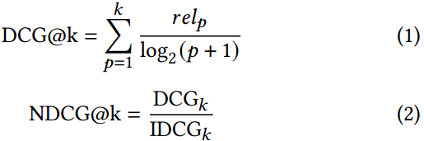
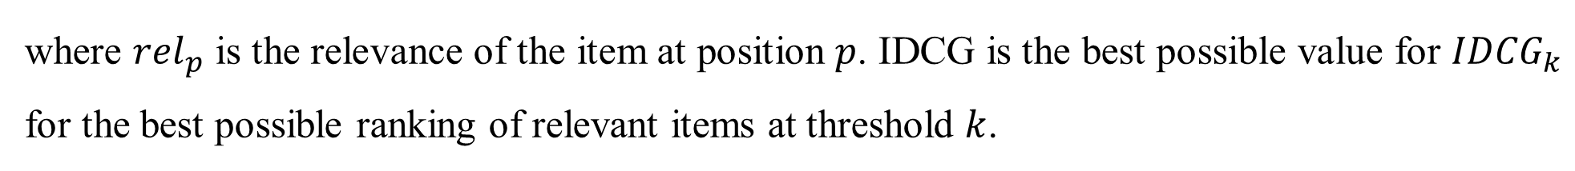
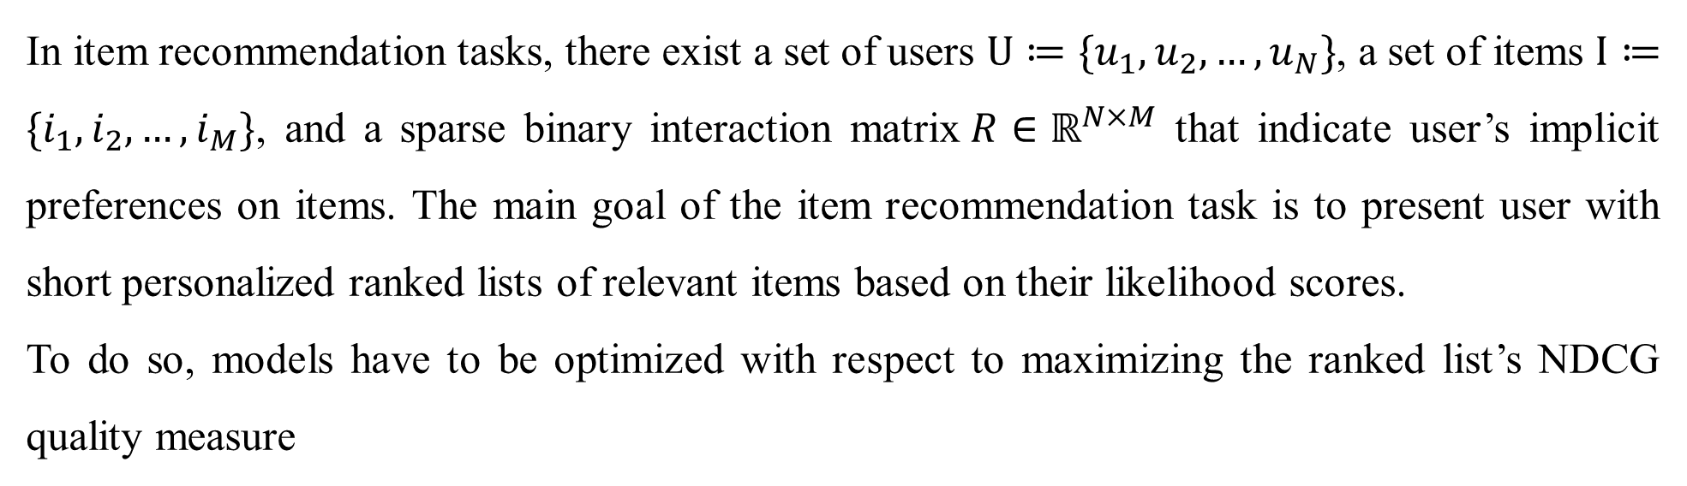
Problem Definition
In item recommendation tasks, there exist a set of users $U≔\{u_{1},u_{2},…,u_{N}\}$, a set of items$I≔\{i_{1},i_{2},…,i_{M}\}$, and a sparse binary interaction matrix$R∈ℝ^{N×M}$ that indicate user’s implicit preferences on items. The main goal of the item recommendation task is to present user with short personalized ranked lists of relevant items based on their likelihood scores.
To do so, models have to be optimized with respect to maximizing the ranked list’s NDCG quality measure
where ${rel}_{p}$ is the relevance of the item at position $p$. IDCG is the best possible value for ${IDCG}_{k}$ for the best possible ranking of relevant items at threshold $k$.

Slide 3
Challenges and Contributions
As NDCG is non-differentiable, it cannot be optimized by gradient-based optimization procedures directly.
Surrogate losses have been engineered that aim to make learning recommendation and ranking models that optimize NDCG possible. However, this approach suffers from stability issues similar GAN.
An alternative guided learning approach for surrogate losses are proposed.
Learning the surrogate loss in parallel to learning the recommender model using the original logistic loss to stabilize the learning phase.

Slide 4
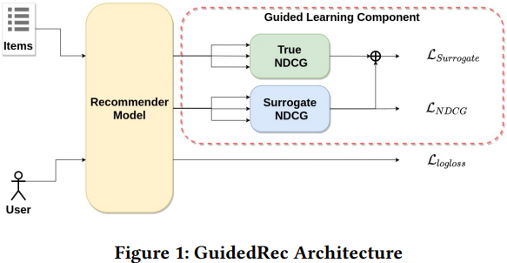
Methodology

Slide 5
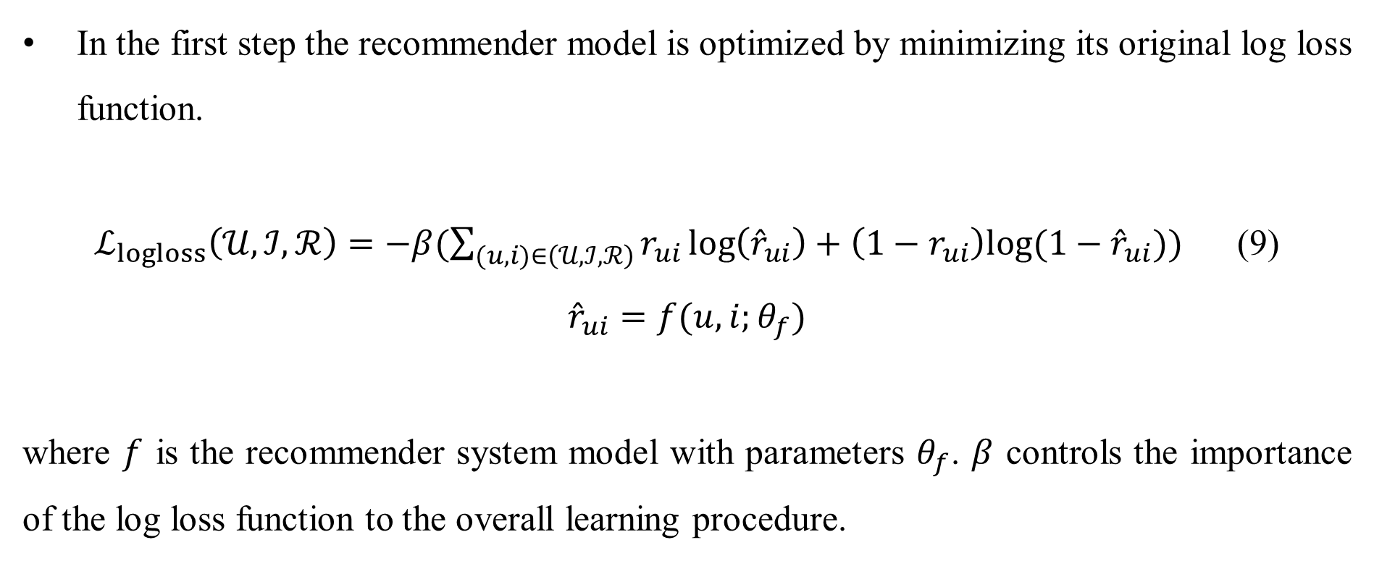
Logloss
In the first step the recommender model is optimized by minimizing its original log loss function.
$ℒ_{logloss}\left(𝒰,ℐ,ℛ\right)=−β(\sum_{(u,i)∈\left(𝒰,ℐ,ℛ\right)}{r_{ui}\log\left({\hat{r}}_{ui}\right)+\left(1−r_{ui}\right)log⁡(1−{\hat{r}}_{ui})})$ (9)
$${\hat{r}}_{ui}=f(u,i;θ_{f})$$
where $f$ is the recommender system model with parameters $θ_{f}$. $β$ controls the importance of the log loss function to the overall learning procedure.

Slide 6
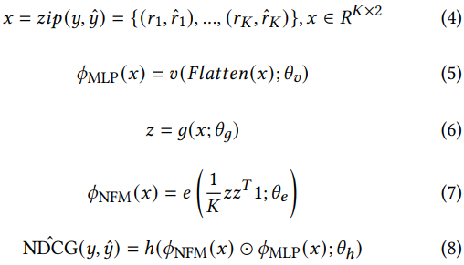
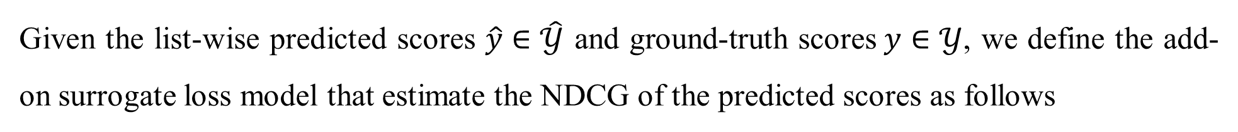
Surrogate Loss Model
Given the list-wise predicted scores $\hat{y}∈\hat{𝒴}$ and ground-truth scores$y∈𝒴$, we define the add-on surrogate loss model that estimate the NDCG of the predicted scores as follows
where $g,v,e$ and $h$ are a series of non-linear fully connected layers with weights $θ_{g},θ_{v},θ_{e}$ and $θ_{h}$ respectively, and ⊙ denotes the element-wise product of two vectors.

Slide 7
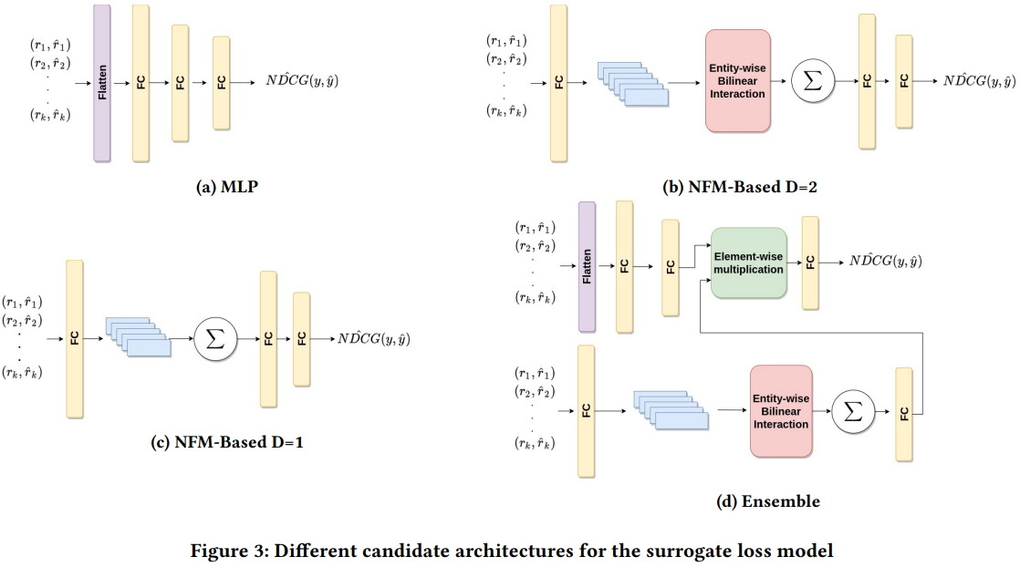
Surrogate Loss Model

Slide 8

Surrogate Loss and NDCG Loss
Surrogate Loss
$ℒ_{Surrogate}\left(𝒴,\hat{𝒴}\right)=\sum_{(y,\hat{y})∈zip\left(𝒴,\hat{𝒴}\right)}{{(NDCG\left(y,\hat{y}\right)−N\hat{DC}G\left(y,\hat{y}\right))}^{2}}$ (10)
NDCG Loss
$ℒ_{NDCG}\left(𝒴,\hat{𝒴}\right)=\sum_{(y,\hat{y})∈zip\left(𝒴,\hat{𝒴}\right)}{−N\hat{DC}G\left(y,\hat{y}\right)}$ (11)

Slide 9
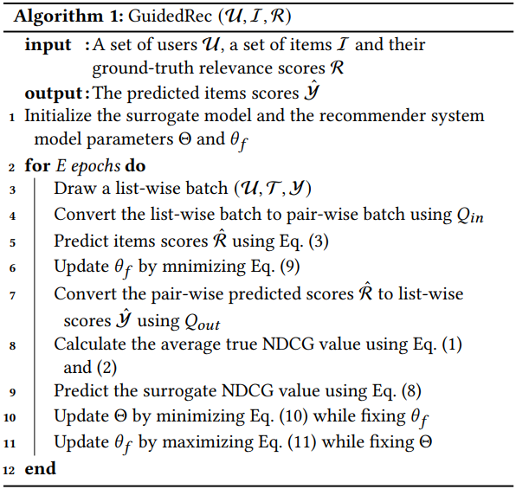
The Pseudo-code of GuidedRec

Slide 10
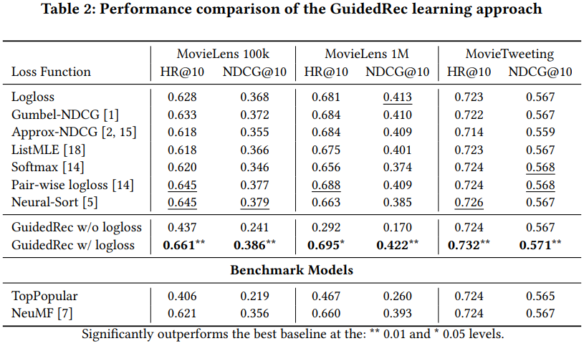
Experiments

Slide 11
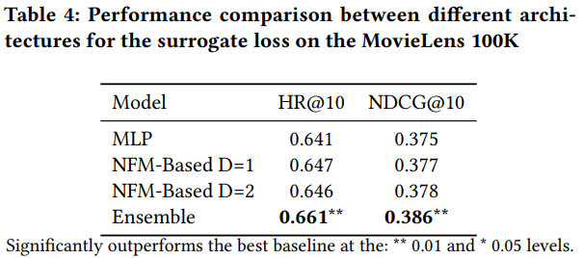
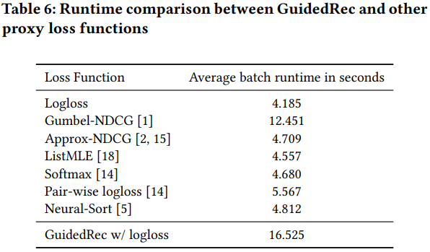
Experiments

